Slide 1

DIRECT Presentation
Amy Stegmann
Edwin Shenjian Jiang
Elena Shoushpanova
Kacper Lachowski

Slide 2
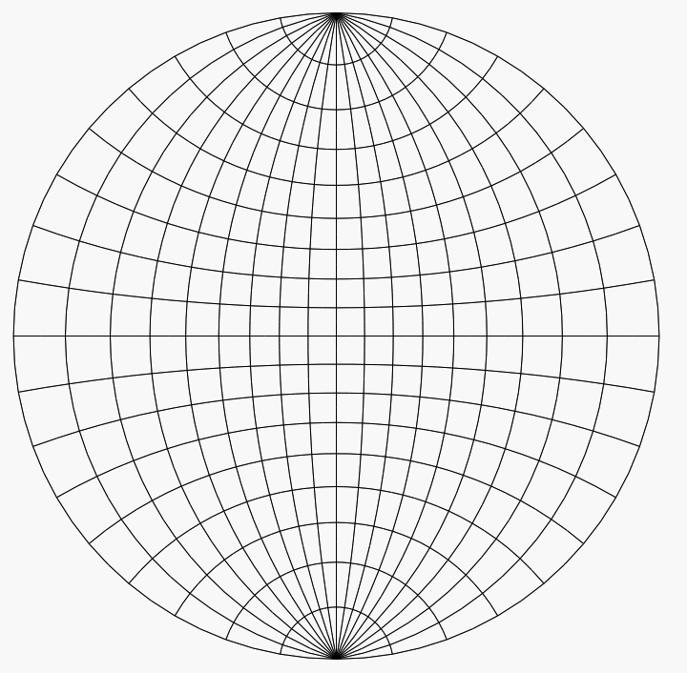
Outline
Wulff net - Crystallographic Projection Model
Motivation
Use Cases
Methods
Image processing
Math
Web Scraping
Data Analysis
Future Work
By Joshuardavis - Own work, Public Domain, https://commons.wikimedia.org/w/index.php?curid=3214934
Notes:
You need to provide a short, concise background on your project including motivation and need. Emphasize the novelty of the approach, data, and general originality.
You will need to talk about the user stories and associated use cases.
You will want to talk about some of the software engineering tools you used (testing, CI, etc.)
You will want to talk about how you used some of the data science methods to further the goals of the project plan.
You will need to present a summary of the results. This can be a demo, a demo notebook, or other results from your tool.
Spend about 30 seconds talking about lessons learned
The goal of our project is to create Python package that automatically determines Zone Axis for any TEM image of a crystal. There are few technological steps in this process, and we are going to talk about three of them: data storage, image processing and web scraping.

Slide 3
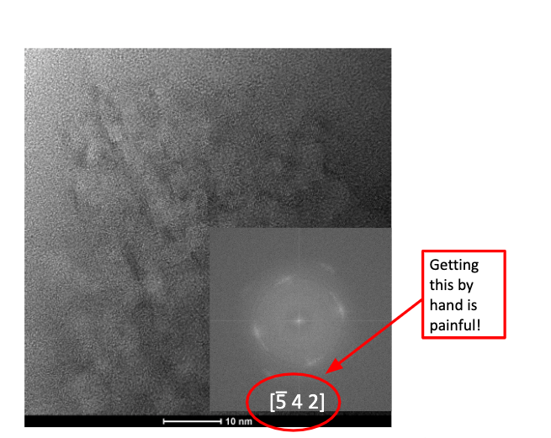
Motivation
Indexed planes are needed to publish
Manual methods are hours of guess and check in a spreadsheet
Notes:
The goal of our project is to create Python package that automatically determines Zone Axis for any TEM image of a crystal. There are few technological steps in this process, and we are going to talk about three of them: data storage, image processing and web scraping.
say what the high res tem image is, say what an FFT is

Slide 4

Use Cases
Over_worked_grad_student is studying some crystals using HRTEM.
They have gorgeous images and now they need to index them
Image Processing (FFT point selection, scale ratio)
Calculate angles and d spacing
Query American Mineral Society database
Calculate zone axis

Slide 5
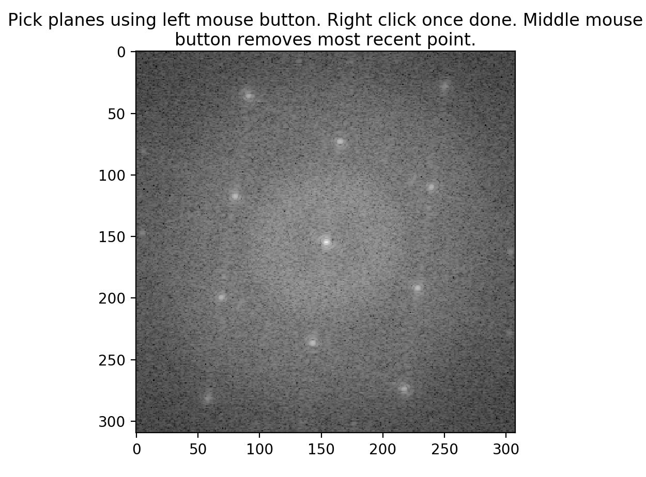
Methods: Image Processing
Get the scale ratio from an image
Generate an FFT
Identify the location of the dots in the FFT

Slide 6
Methods: Web Scraping
The American Mineralogist crystal structure database
http://rruff.geo.arizona.edu/AMS/result.php?diff=vals(3.3,3.713),opt(),type(d-spacing),tolerance(.01)
tolerance
d spacing 1
d spacing 2
Compile Potential Crystal Structures with metadata:
[((dataframe of data from first mineral),(dataframe of metadata from first mineral)), (next pair of dataframes in a tuple)...(n^{th} pair)]

Slide 7
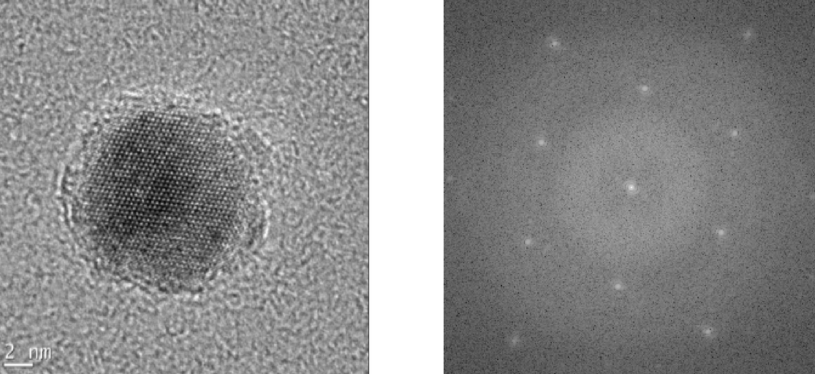


Methods: Getting angles from FFT
Uploaded Image
Image FFT
Point 1 (a1, b1)
Point 2 (a2, b2)
Θ
Origin (0,0)
2 nm
Image courtesy of Soohyung Lee, UW ChemE

Slide 8

Methods: Getting d spacing from FFT
Uploaded Image
Image FFT
Point 1 (a1, b1)
Point 2 (a2, b2)
Origin (0,0)
2 nm
Image courtesy of Soohyung Lee, UW ChemE

Slide 9
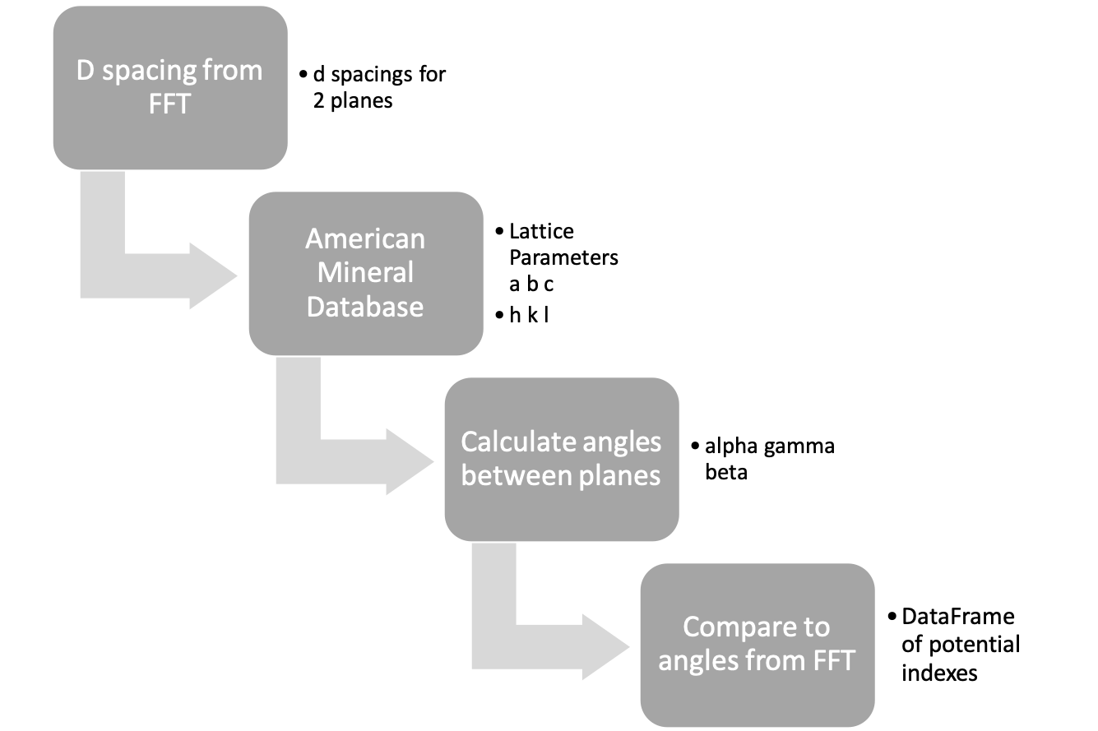
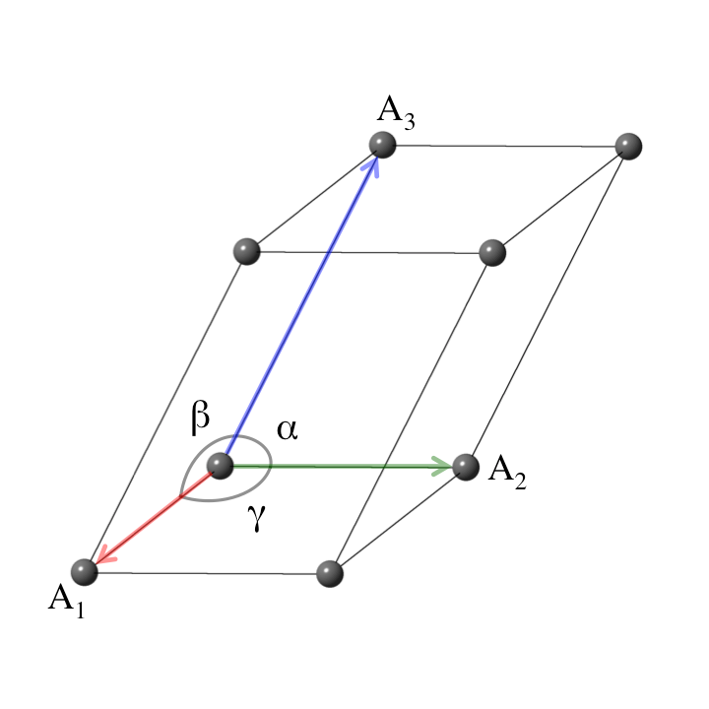
Methods: angles from lattice parameters
a
b
c
http://aflowlib.org/CrystalDatabase/triclinic_lattice.html
Notes:
our process was designed to be general, we have tested it on monoclinic, triclinic, and hexagonal crystal lattices

Slide 10
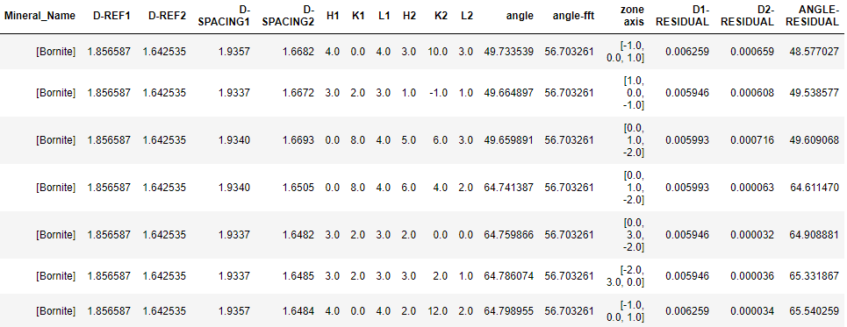
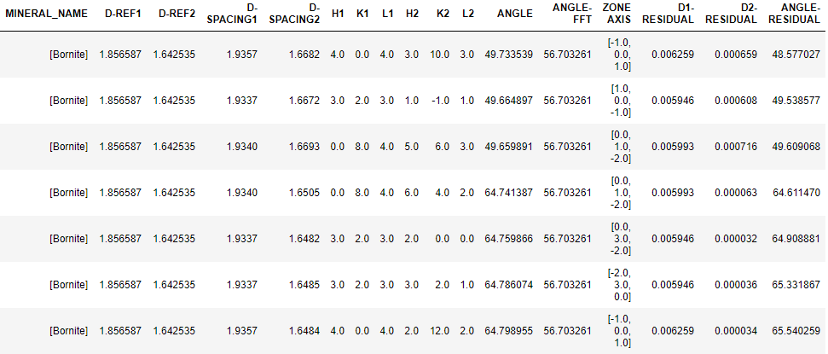
Methods: How is this work Data Science?
Reproducibility: Easily document steps to producing zone-axis
Statistical Significance:
Score Function
Plane 1 Plane 2
D Spacing 1
Angle Between Planes

Slide 11
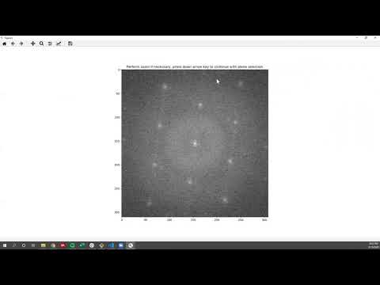
Project Flow

Slide 12
Results: Demo Example
Uploaded Image
Image FFT
Point 1 (a1, b1)
Point 2 (a2, b2)
Image courtesy of Soohyung Lee, UW ChemE
Notes:
After user has finished clicking on the FFT image, the results will be automatically generated and arranged into a data table that contains:
the information about d-spacings, HKL indices of corresponding planes, an angle between them, and a calculated zone axis.

Slide 13
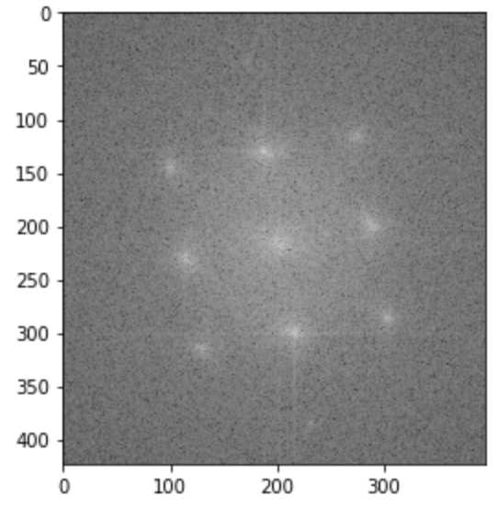
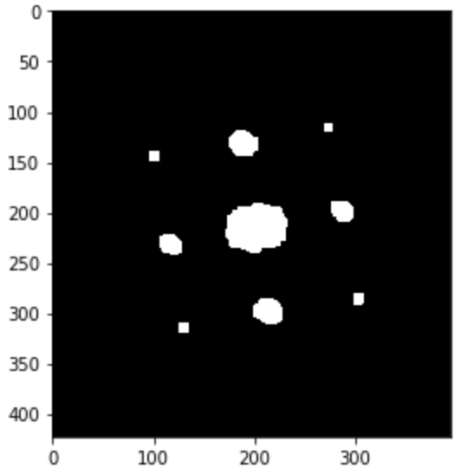
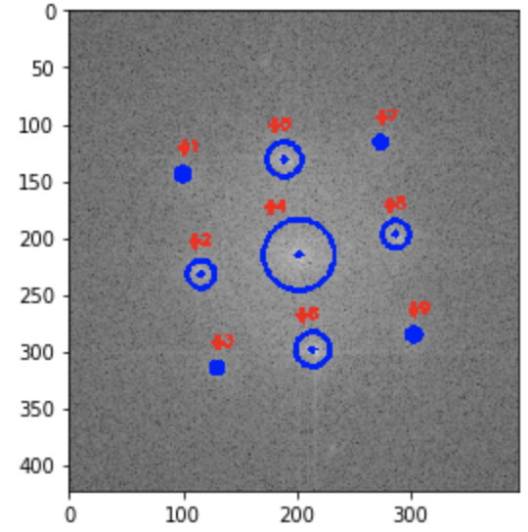
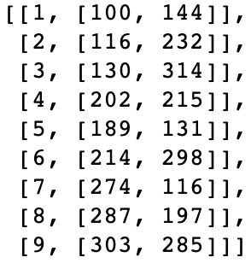
Future Work
Finish Automatic Plane Recognition from FFT
Connected component analysis on the thresholded image
cv2.GaussianBlur
cv2.threshold
cv2.erode
cv2.dilate
Output coordinates
FFT image
Notes:
If we had more time we would work on several improvements:
First would be the automatic recognition of the dots in FFT. We already started working on that.
We use a blur filter to reduce a background noise, then apply threshold function to make a clear distinction between background and points. Then perform connected component analysis on the thresholded image to find coordinates of white features.
To get this working, we need to find a way to make a filters set universal, and to get the scale bar ratio automatically.

Slide 14
Future Work - cont.
Handle massive search results
Batch Processing
Plot zone axis per frame of in situ videos
Notes:
We also want to be able to make a batch process for multiple images, and for each frame of the insitu TEM videos.

Slide 15
Regrets? What would we do differently?
Continuous integration from the git-go
Contacted the database manager sooner, he’s very interested in our project!
Notes:
If we could start the project over, we would use continuous integration from the beginning,
and we would contact database manager sooner as he is very interested in our project.

Slide 16
Thank you
You, for your attention
Soohyung Lee, Alex Bard, for contributing HRTEM images
Ting and Dave, Ted Cohen, Jimin Qian, Torin Stetina, Caitlyn Wolf, for being fantastic instructors
Stack Overflow, for saving our instructors extra office hour time

Slide 17
References
Downs, R.T. and Hall-Wallace, M. (2003) The American Mineralogist Crystal Structure Database. American Mineralogist 88, 247-250.
Cullity, B. D., & Stock, S. R. Elements of X-ray diffraction. 3rd ed2001. ISBN No: 0-201-61091-4.
Somnath, S., Smith, C. R., Laanait, N., Vasudevan, R. K., Ievlev, A., Belianinov, A., ... & Jesse, S. (2019). USID and Pycroscopy--Open frameworks for storing and analyzing spectroscopic and imaging data. arXiv preprint arXiv:1903.09515.
https://neutron.ornl.gov/user_data/hb3a/exp16/tools/Crystal%20Plane%20Spacings%20and%20Interplanar%20Angles.htm

